Slide 1
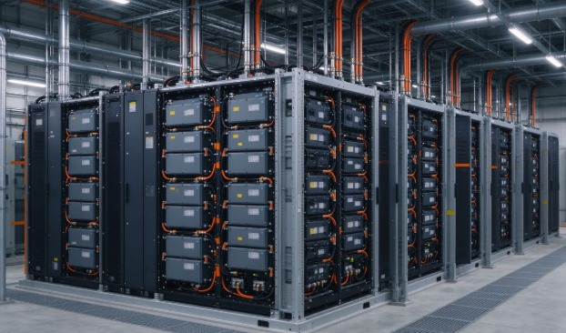




KENFA TECH
INDUSTRIAL LIMITED
Company Profile-2026
King Lee 2026/1/5

Slide 2
Index
Introduction
KENFA Corporate overview
Product overview
Manufacturing capabilities

Slide 3
KENFA TECH
Corporate overview

Slide 4
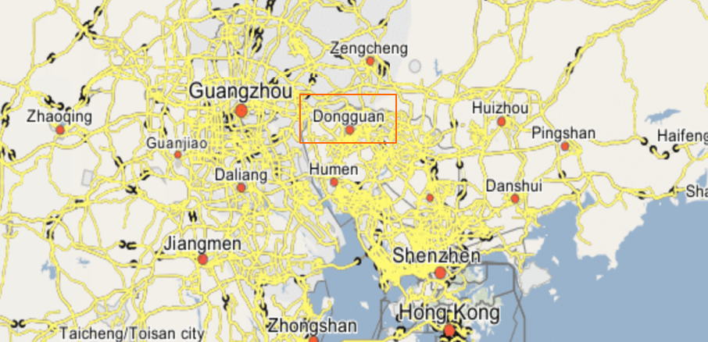
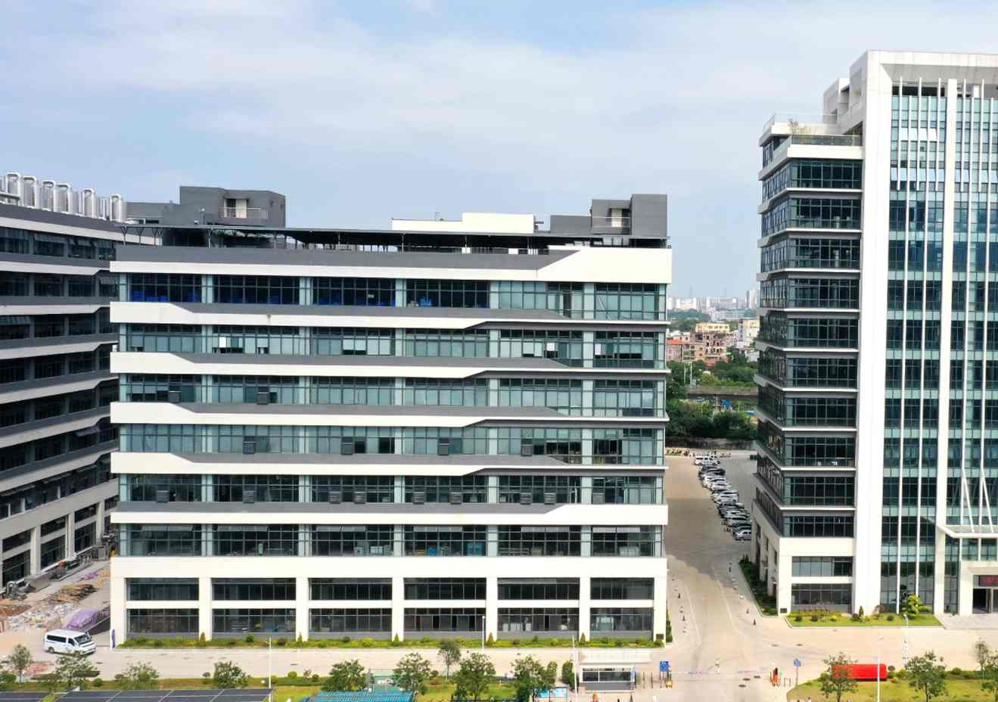
Global Business
China Factory
We are a full-stack thermal management manufacturer and design provider. Founded in 2012, our company is located in Dongguan, Guangdong, China.
Global Customer Service
Anticipate thermal management needs for Europe and North America, and meet them with high-performance heat sinks, liquid cooling components and services in a timely and cost-effective manner.
World Wide Sales and Distribution
Support product development cycles with dedicated engineering resources. We attend exhibitions in Germany and Hong Kong every year.
Design Services
Guide our customers through thermal design issues at all stages of product development from concept to mass production, delivering cooling solutions that build competitive advantage.
Quality Management Systems
Pursue strict quality and reliability standards backed by continuous improvement, ISO 9001 and IATF 16949 certified.

Slide 5



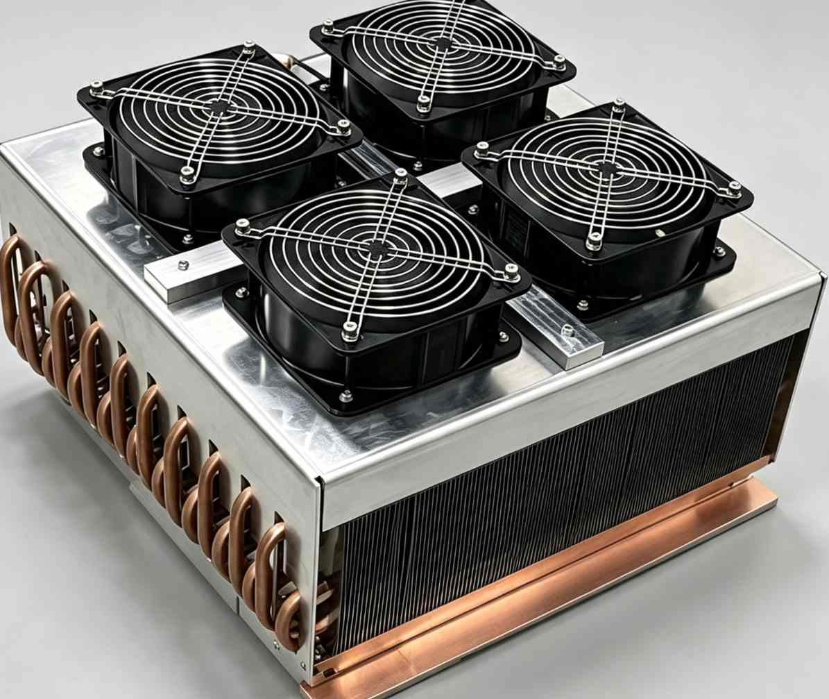
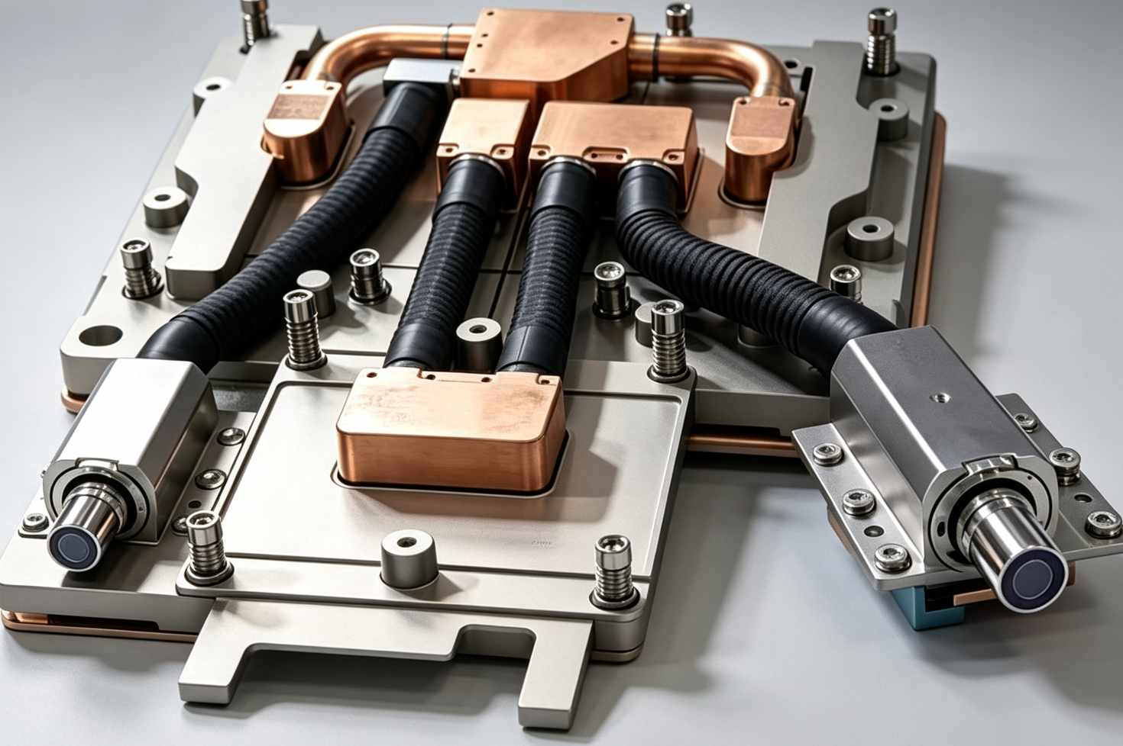
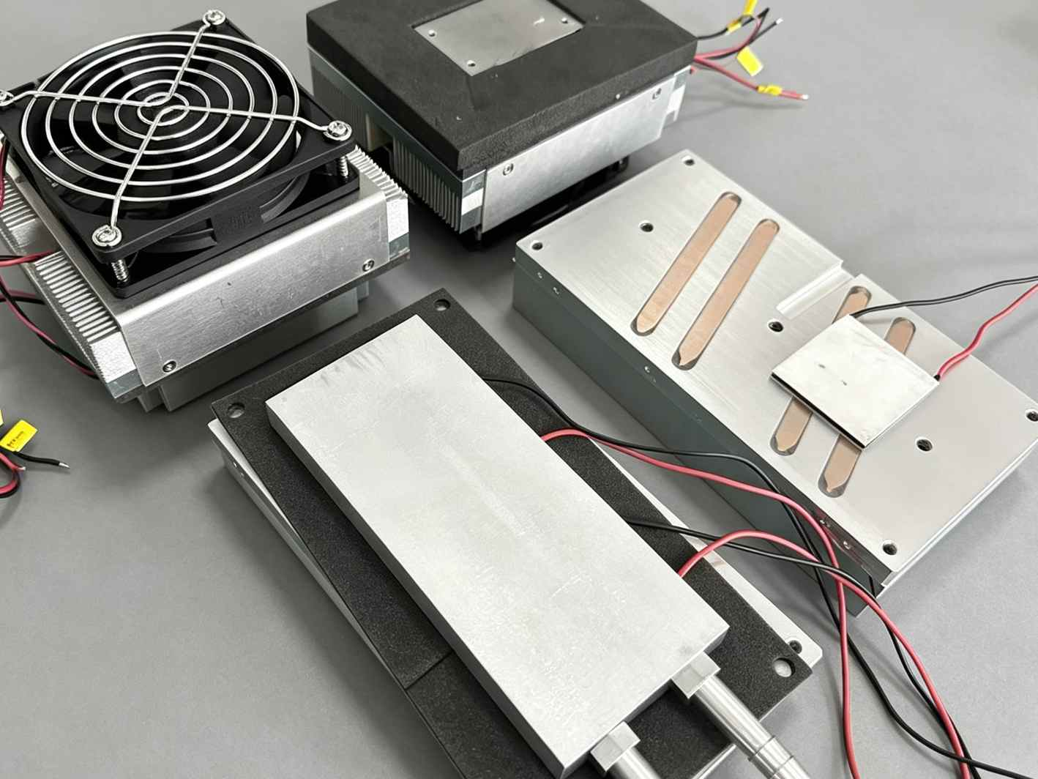
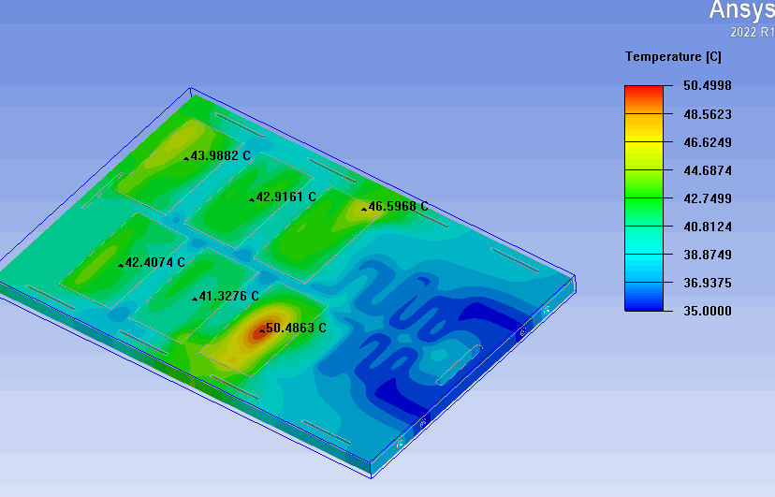
The Fully Integrated Solution for Electronic Cooling
What we can offer
Heat sinks
Liquid cold plates
Thermoelectric Assembly
Thermal
design
Tube embedding, Friction stir welding, Brazing and extruded channel .
Offering customized thermal design solutions analysis software including Ansys Icepak and Flotherm
Manufacturing processes including Extrusion, skived fin, heat pipe soldering, brazing and epoxy bonded fins.
Supply TEA modules of various specifications to satisfy clients' precise temperature control requirements.

Slide 6










Vision Statement
To be recognized as the premier provider of thermal solutions and program management services by our customers

Slide 7
KENFA TECH
Product Overview

Slide 8
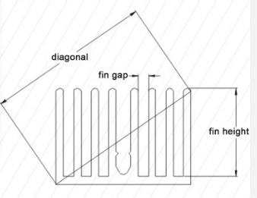
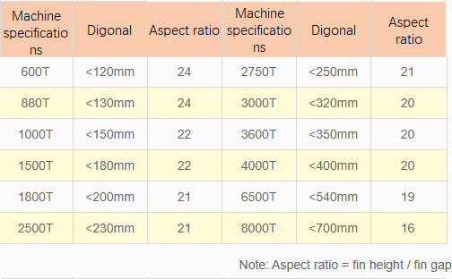
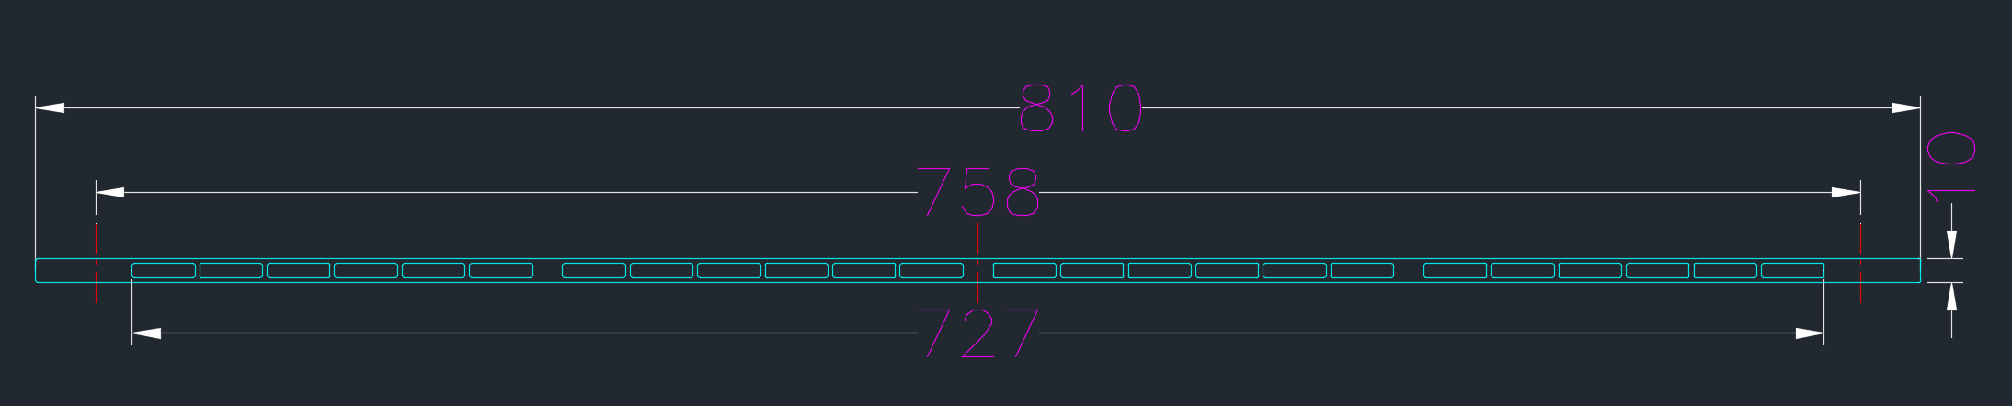
Customized Heat sink solutions
Custom Fabricated Extrusion
Material:AL6063 / AL1060 Aluminum Alloy
Maximum Mold Diagonal 810mm
Fin Height to Air Gap Ratio 24:1
Engineering-grade High-efficiency Heat Dissipation Molding
Cost Optimization
The mold lead time is generally 2 to 3 weeks.

Slide 9
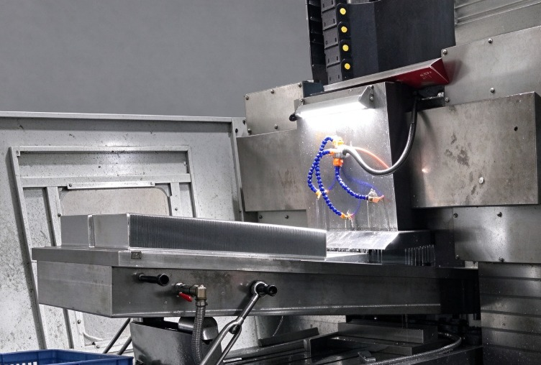
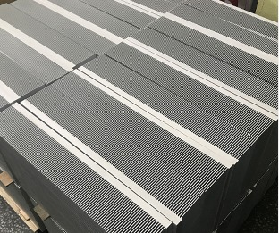
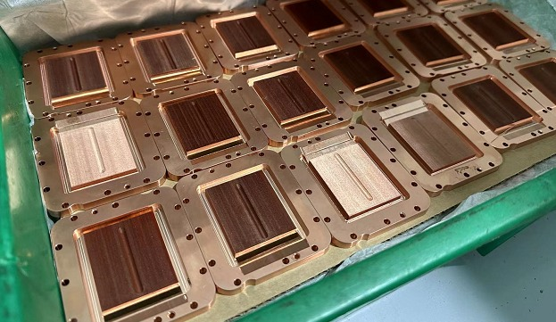
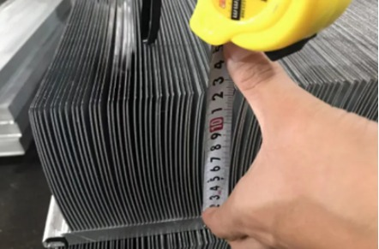
Customized Heat sink solutions
Skived fin Heat sinks
Al 1060/6061/6063/C1100 material
Without tooling charging
Reduced Thermal Resistance
The width can be processed to 750mm
The height can be processed to 120mm
The thickness is 0.1-2.0mm

Slide 10
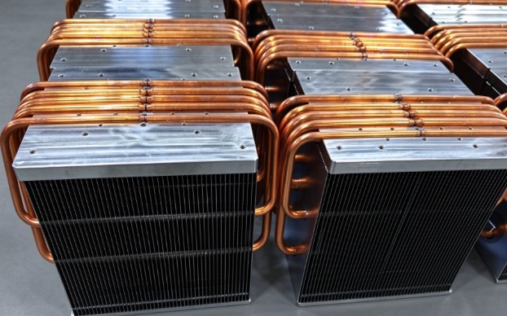
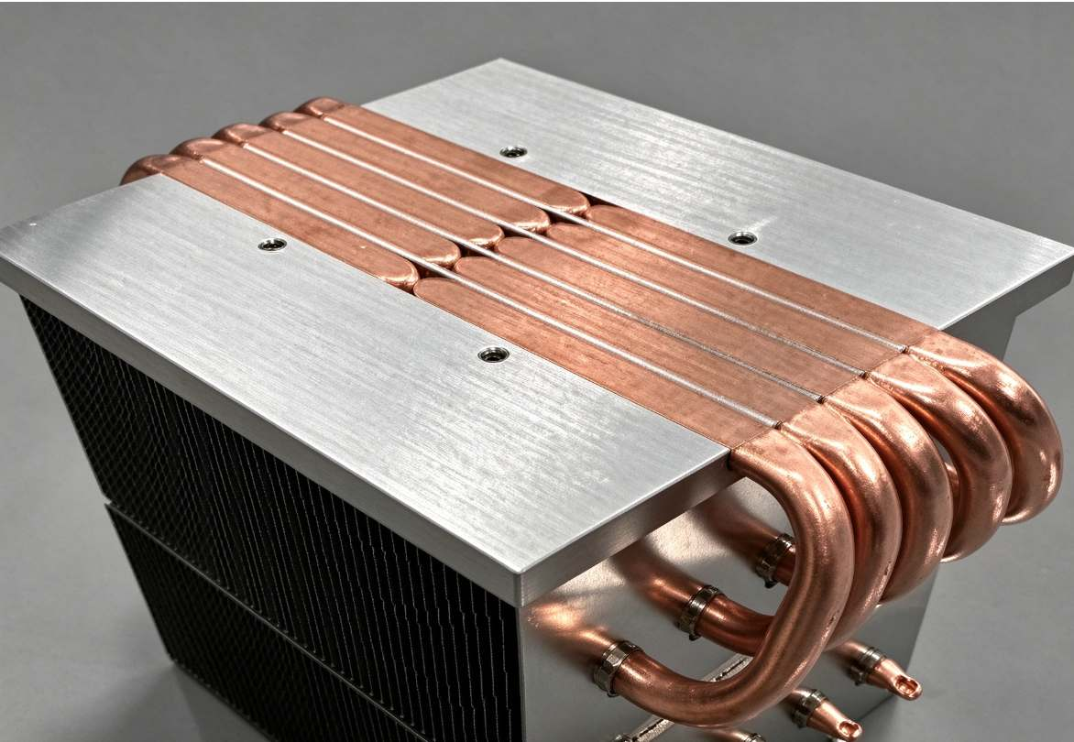
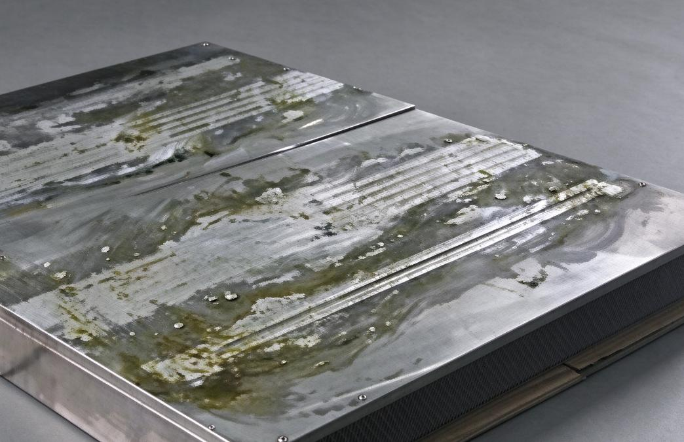
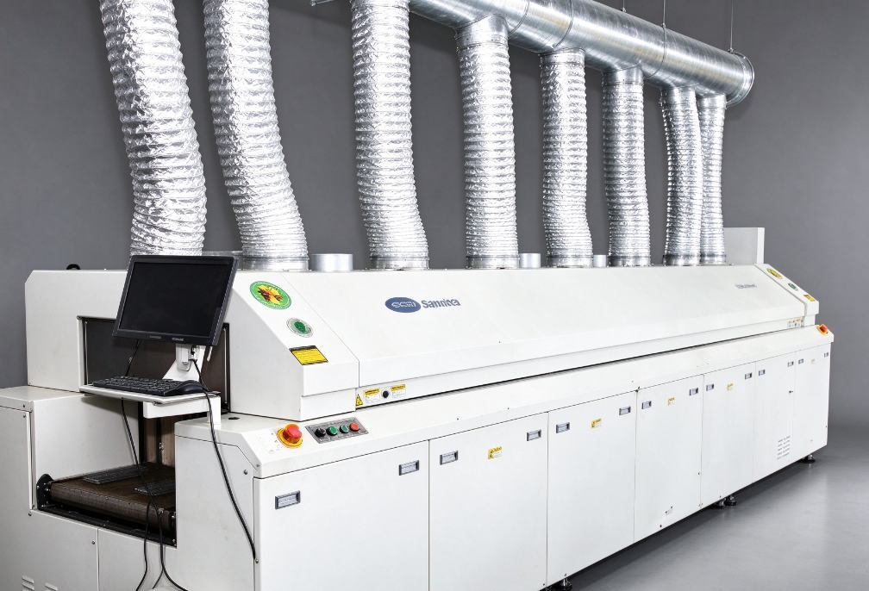
Customized Heat sink solutions
Heat pipe Heat sinks
Available OD of heat pipes: 6.35 mm, 8 mm, 9.52 mm, 10 mm, 12 mm;
Wall thickness options: 0.3 mm, 0.4 mm, 0.9 mm and 1.0 mm
Patented interference-fit grooves reduce thermal resistance;
Al 1100/6063/C1100 material;
Stamped fins with nickel plating.
Welding options: high-temp /low-temp solder paste;
High conductive heat transfer heat sink

Slide 11
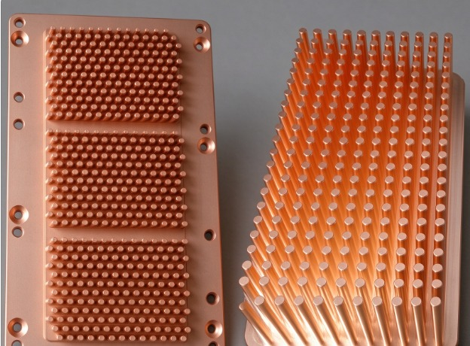
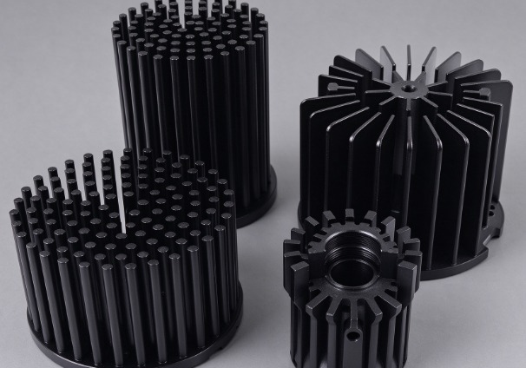
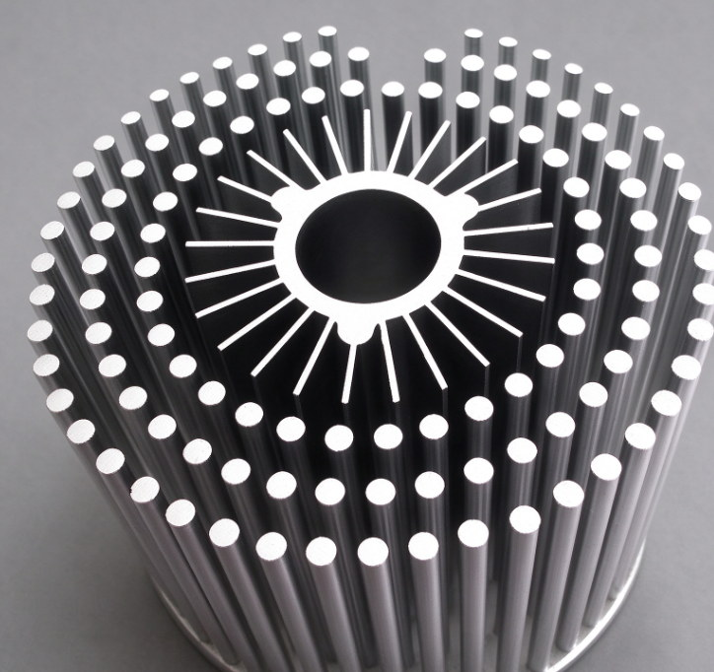
Customized Heat sink solutions
Cold forging Heat sinks
Al 1060/C1100 material;
Need tooling for manufacturing;
Maximum cold forging size 250X300X85mm;
Minimum pin diameter 1.2mm
Pin spacing is at least 1.5mm
Applied to autonomous driving, LED light cooling

Slide 12
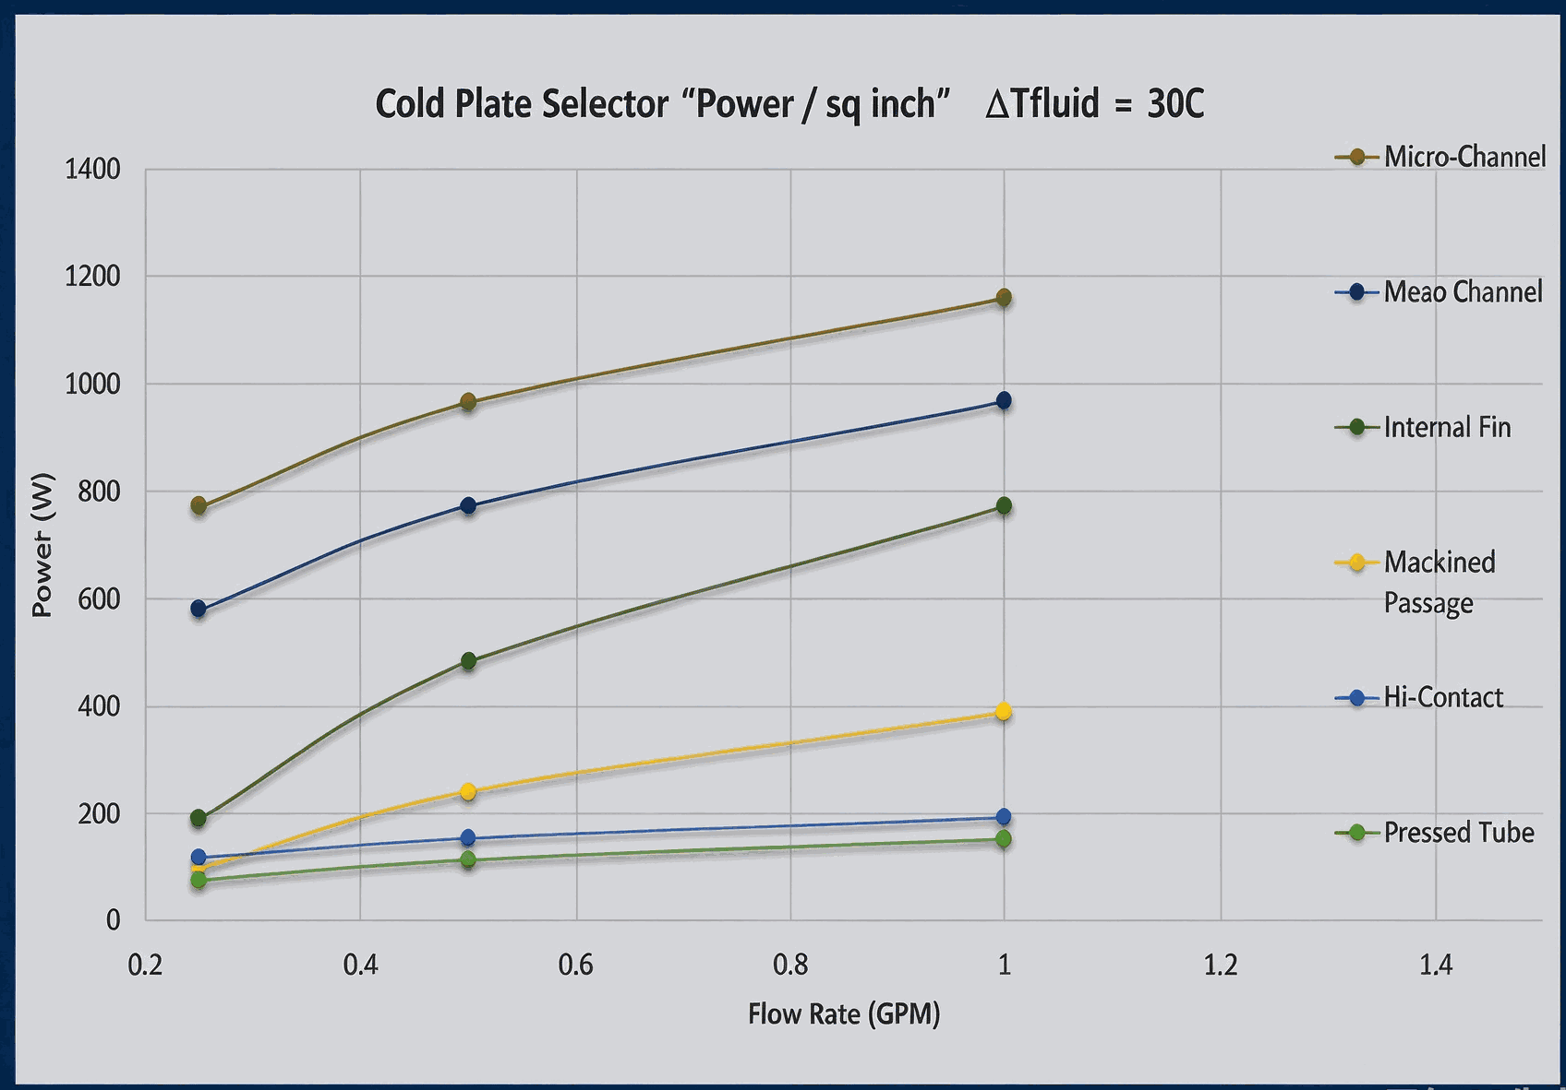
Customized Liquid cooled Solutions
How to design a cold plate
Micro-Channel
Internal fin features are less than 0.05-0.1 mm.
Meso Channel
Internal fin features are less than 0.1-1.0 mm
Internal offset Fin
It adopts a offset fin structure.
Machined Channel
Machined flow channels, fin thickness 1–3 mm.
Pressed tube
Tube structure, wall thickness 0.8–1.2 mm.
Micro-Channel 181W/cm2
Meso Channel 154W/cm2
Internal offset Fin 121W/cm2
Machined Passage 61W/cm2
Pressed tube 24W/cm2
Notes: Heat Dissipation Power (W/cm²) @3.79 L/min

Slide 13
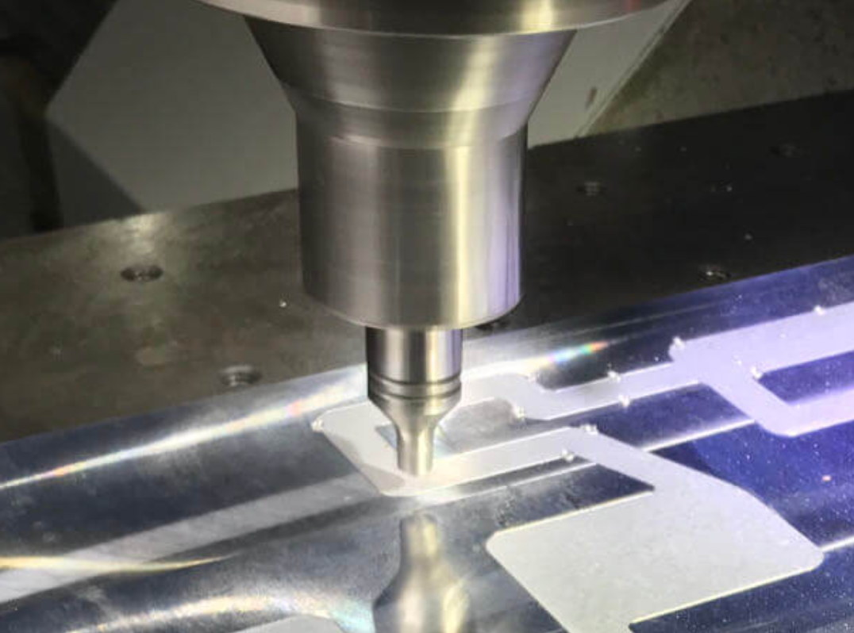
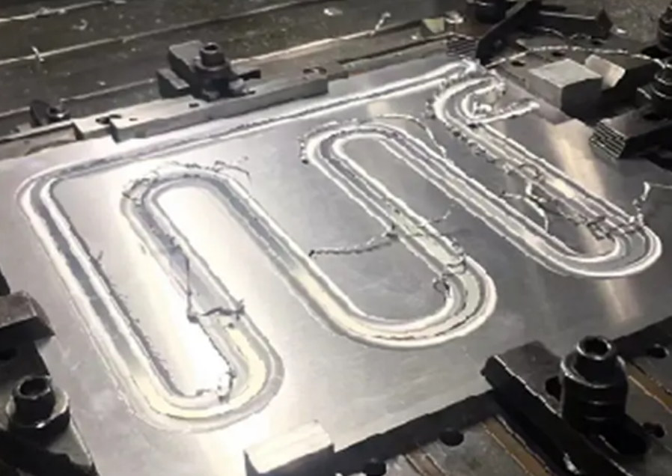
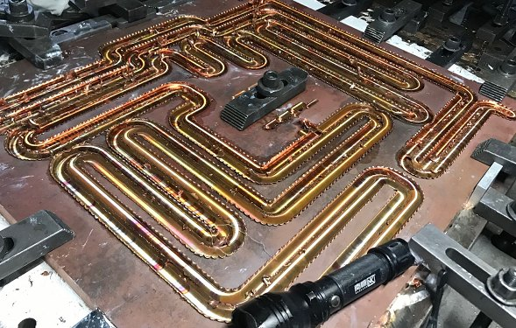
Customized Liquid cooled Solutions
Al 1060/6063/C1100 material;
Need CNC Machining for making Flow channels;
The FSW welding depth is 1-15mm;
Minimum pin diameter 1.2mm
The maximum processing size is 1500X2000mm
Anodized or chromate SurTec 650 coating for finishing
Maximum pressure holding test: 0.7-1.5 Mpa
Cold plate wall thickness between heat source and coolant: 2–4 mm
Friction Stir Welding Cold plate

Slide 14
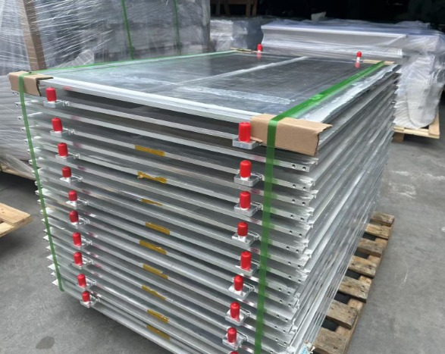
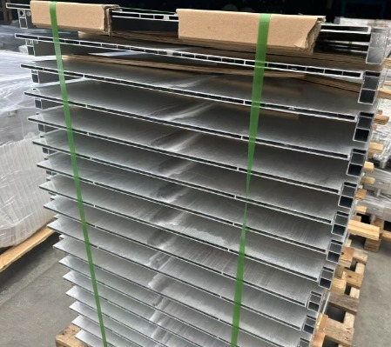
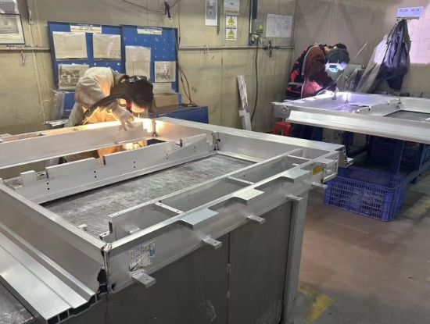
Customized Liquid cooled Solutions
Tig welding Cold plate
Al 6063 material;
Extrusion process making water channels;
Sealing the end caps of liquid cooled plates using Tig welding technology;
The maximum processing size is 1500X2000mm;
Anodized or chromate SurTec 650 coating for finishing;
Maximum pressure holding test: 0.7-1.5 Mpa
The preferred cooling solution for energy storage batteries and power batteries

Slide 15
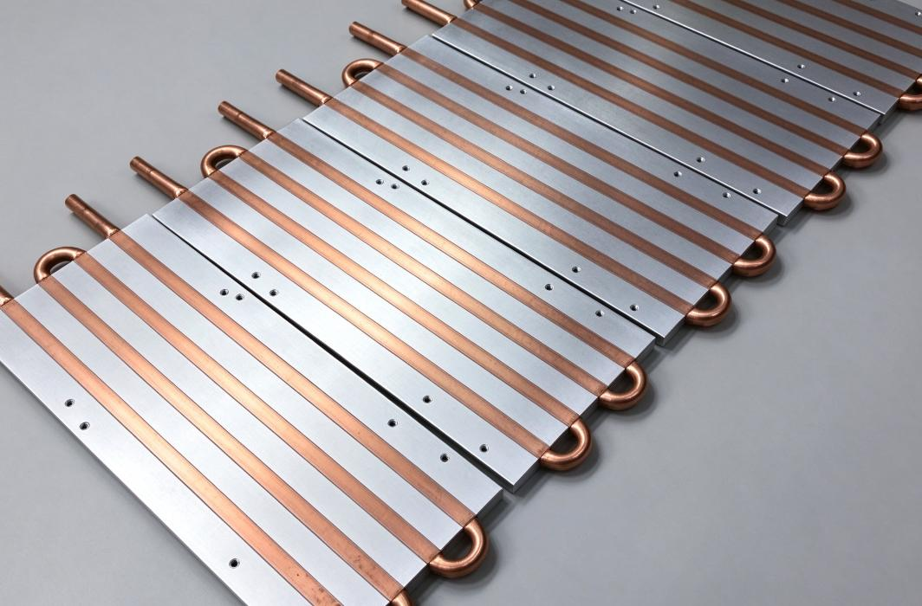
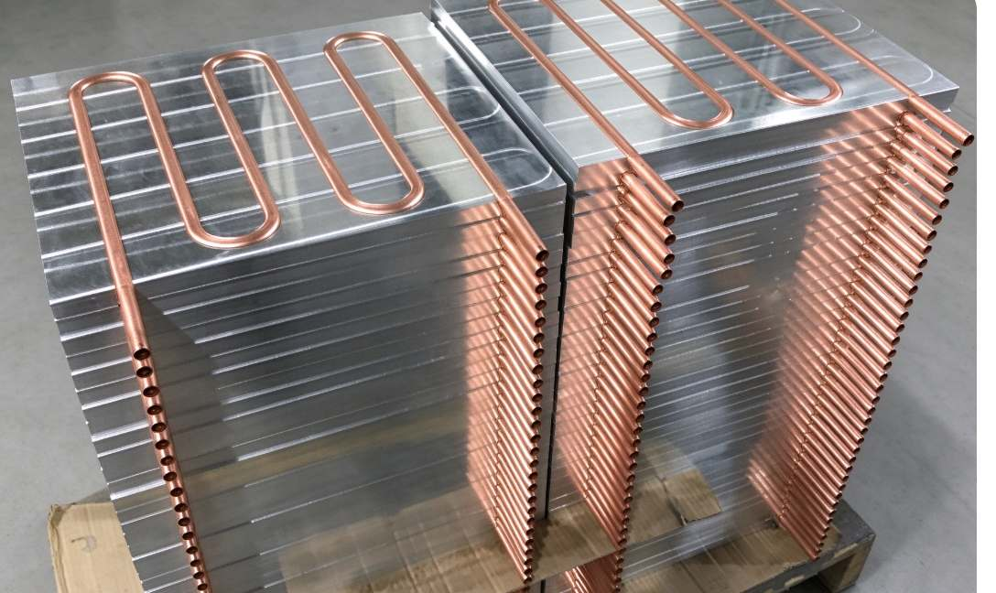
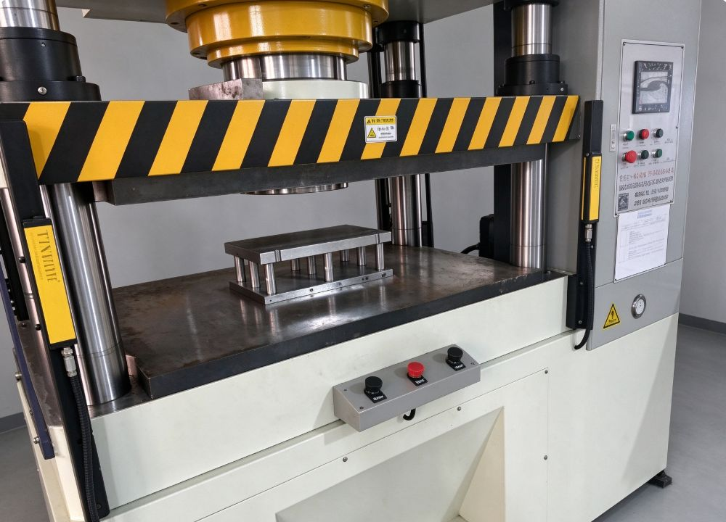
Customized Liquid cooled Solutions
Tube Embedded cold plate
Al 6063/6061 /C1100material for cold plate base;
Standard OD: 6.35, 8, 9.52, 10, 12 mm, tube wall thickness 1.0–1.2 mm;
Hi-Contact technology optimizes the contact area liquid tubes have with a cooling surface;
High thermal conductivity epoxy is used to fill the gaps
Copper or stainless steel tubes can be welded to increase tube density;
Anodized or chromate SurTec 650 coating for finishing;
Maximum pressure holding test: 0.7-1.5 Mpa

Slide 16
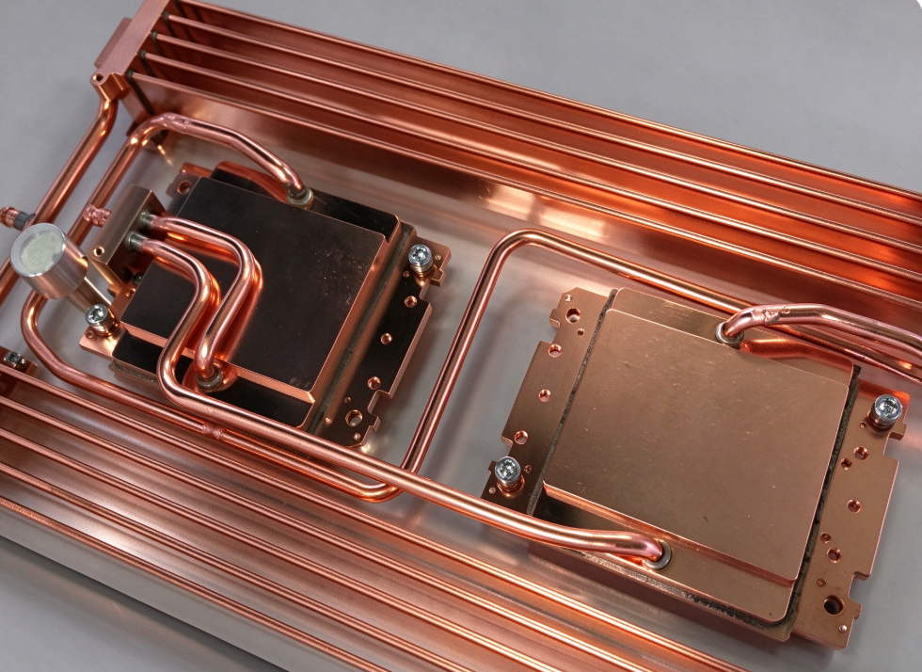
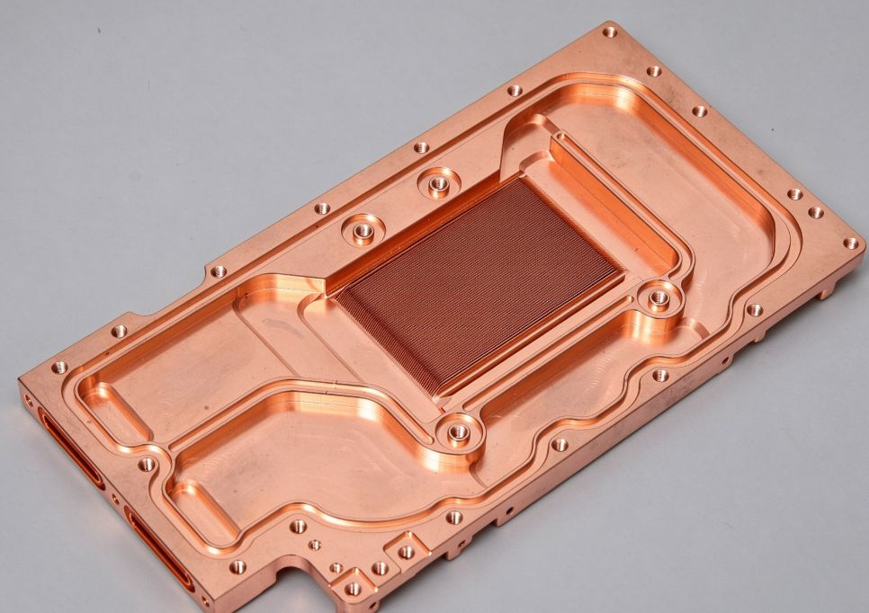
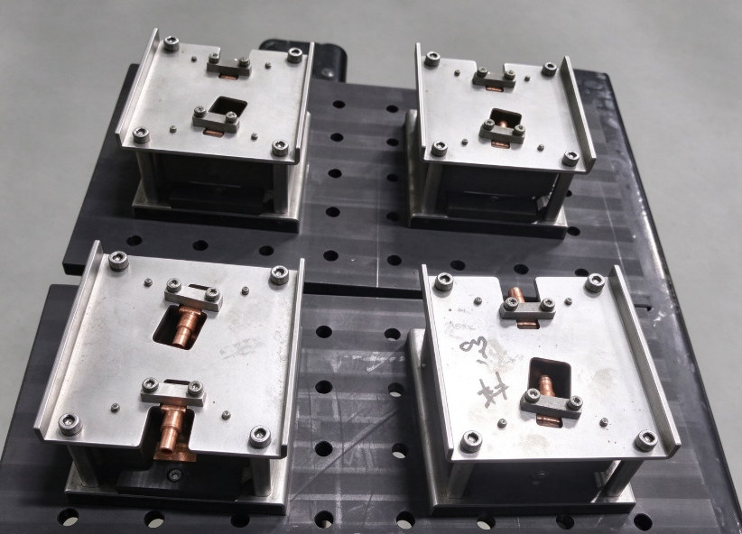
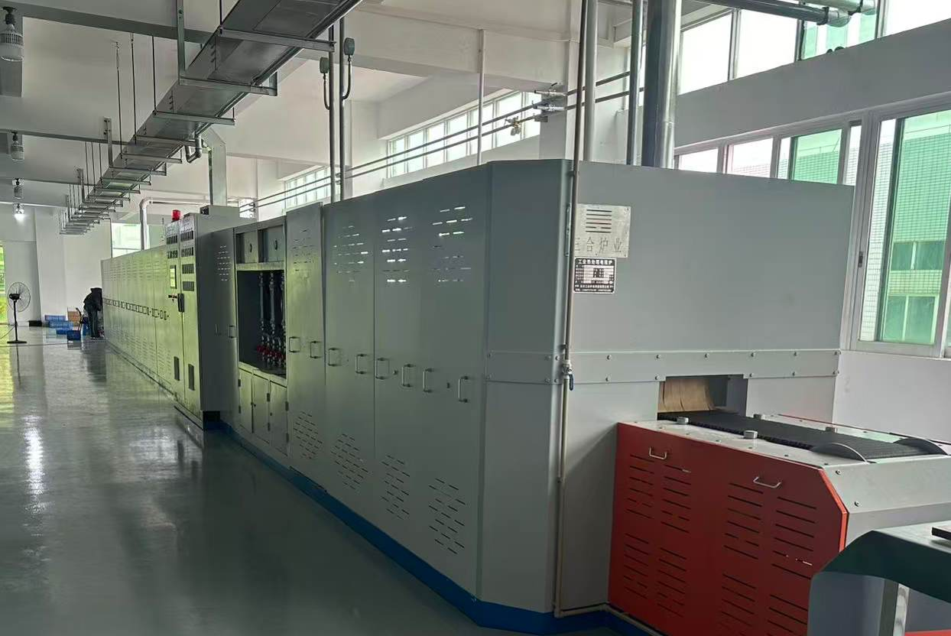
Customized Liquid cooled Solutions
Brazing cold plate
Al 6063/6061 /C1100 material
Micro-channel flow structure improves heat transfer efficiency of coolant
The crystallization temperature of brazed aluminum is 450 degrees and the
copper is 760- 780 degrees;
Nitrogen shielding for welding. Post processes: channel cleaning, pressure leak test, helium leak test, flow resistance test;
Anodized or chromate SurTec 650 coating for finishing;
Maximum pressure holding test: 0.7-1.5 Mpa
Applied to cloudy computing ,CPU ，GPU servers；

Slide 17
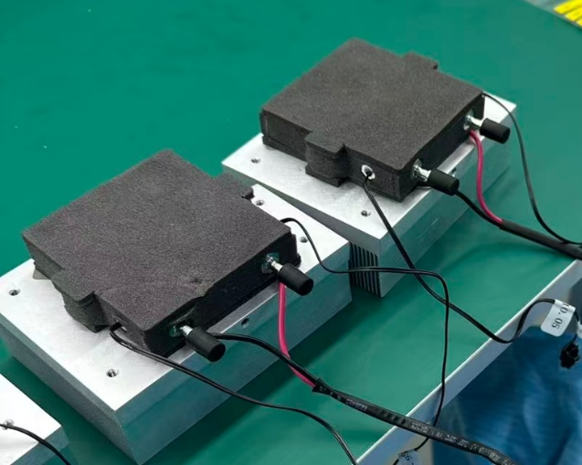
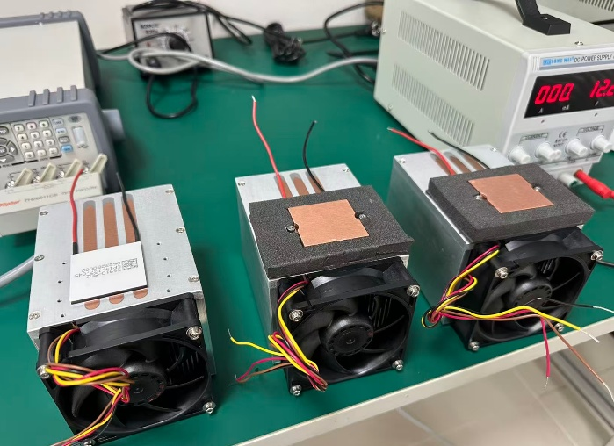
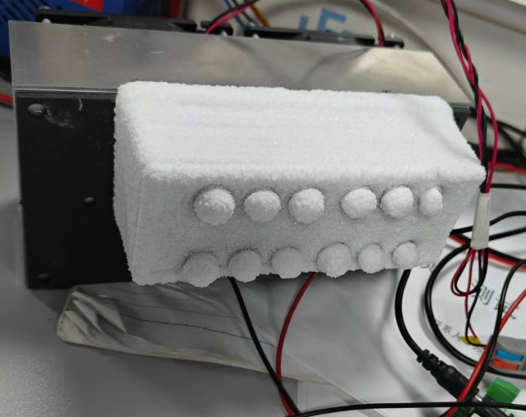
Customized TEA Solutions
Thermoelectric Cooler Assembly
Professional thermal management expertise to reduce the hot-side temperature of TEC；
Microchannel structure maximizes the efficiency of the TEC cold side ；
Custom sizes and standard products are available for customers；
We provide AA, AD, AL and LL modules for customers.

Slide 18
Customized Liquid cooled Solutions
KENFA TECH
Manufacturing Capabilities

Slide 19
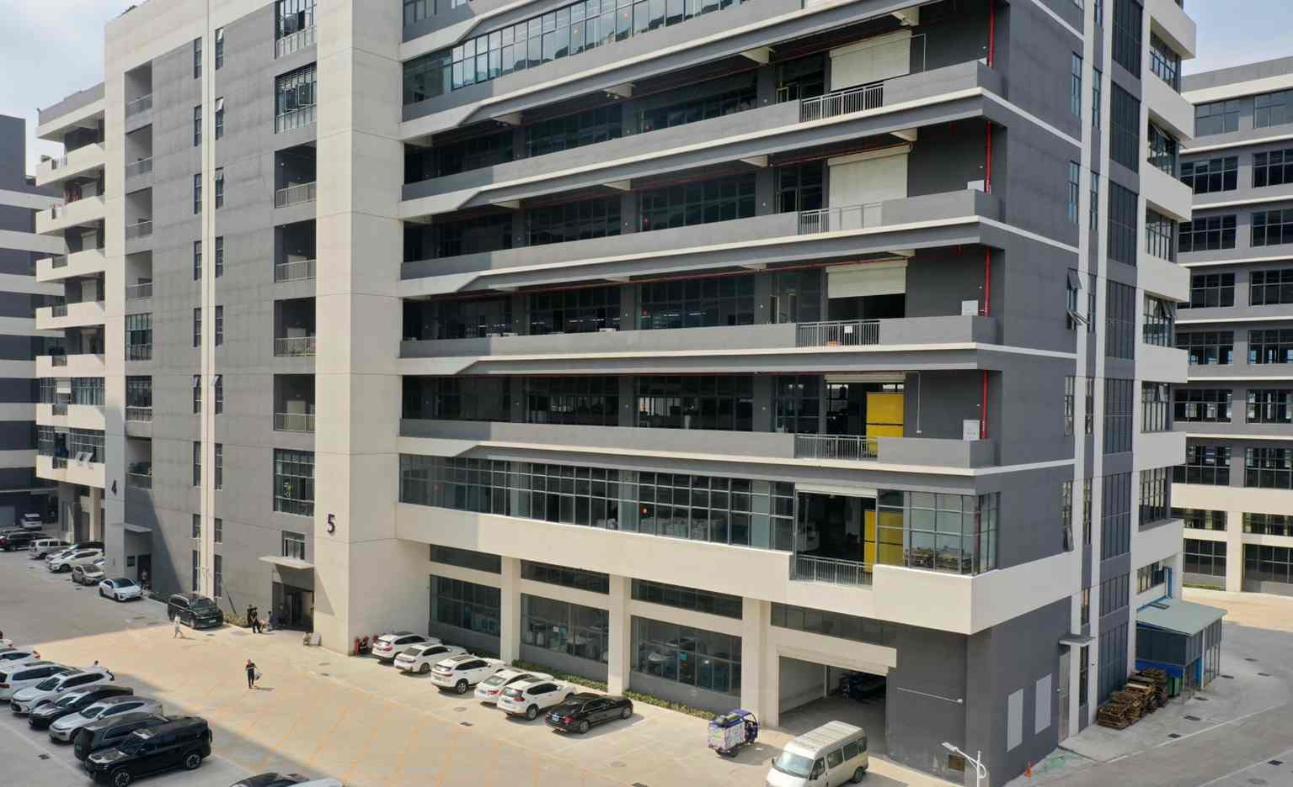
Kenfa factory
Statistics
Size | 6500 m2
Personnel* | 120 Direct 45 Indirect
Product / Process Capabilities
CNC Machining center | CNC machined
Skived fin | Skived fin process
Soldering | Soldering heat pipes
Brazing | Brazing cold plates
Assembly | Assembly, Packing

Slide 20
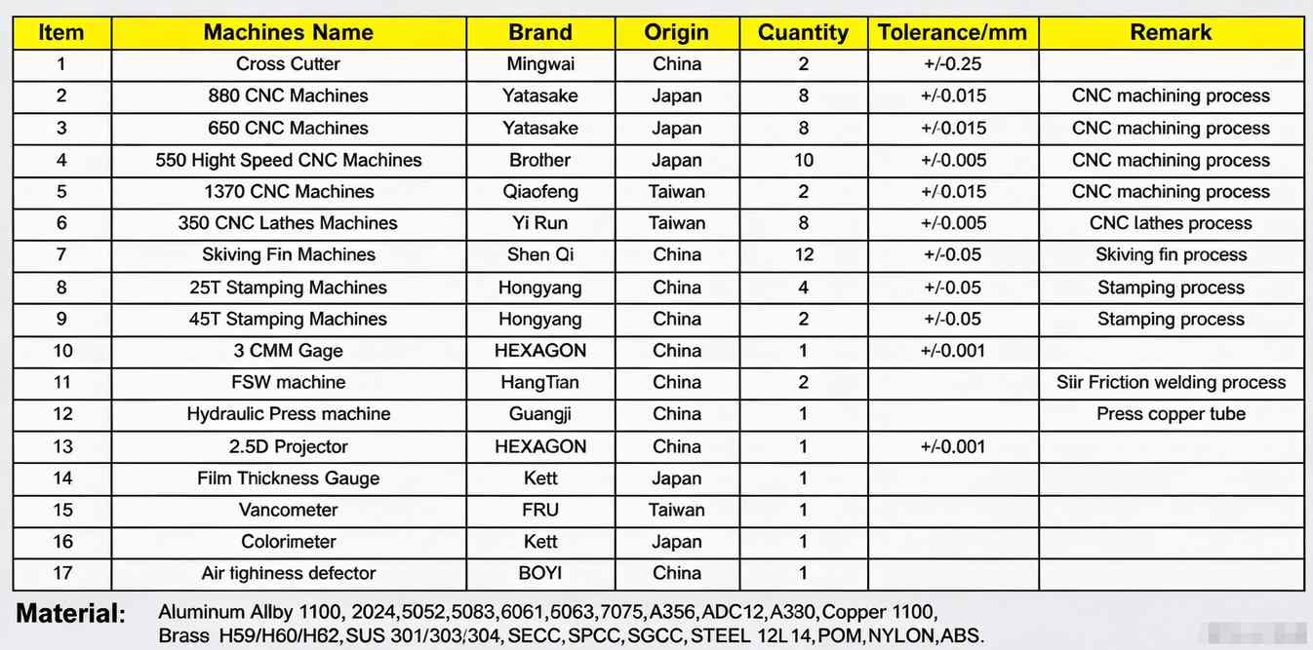
Kenfa factory
Factory Equipment List

Slide 21
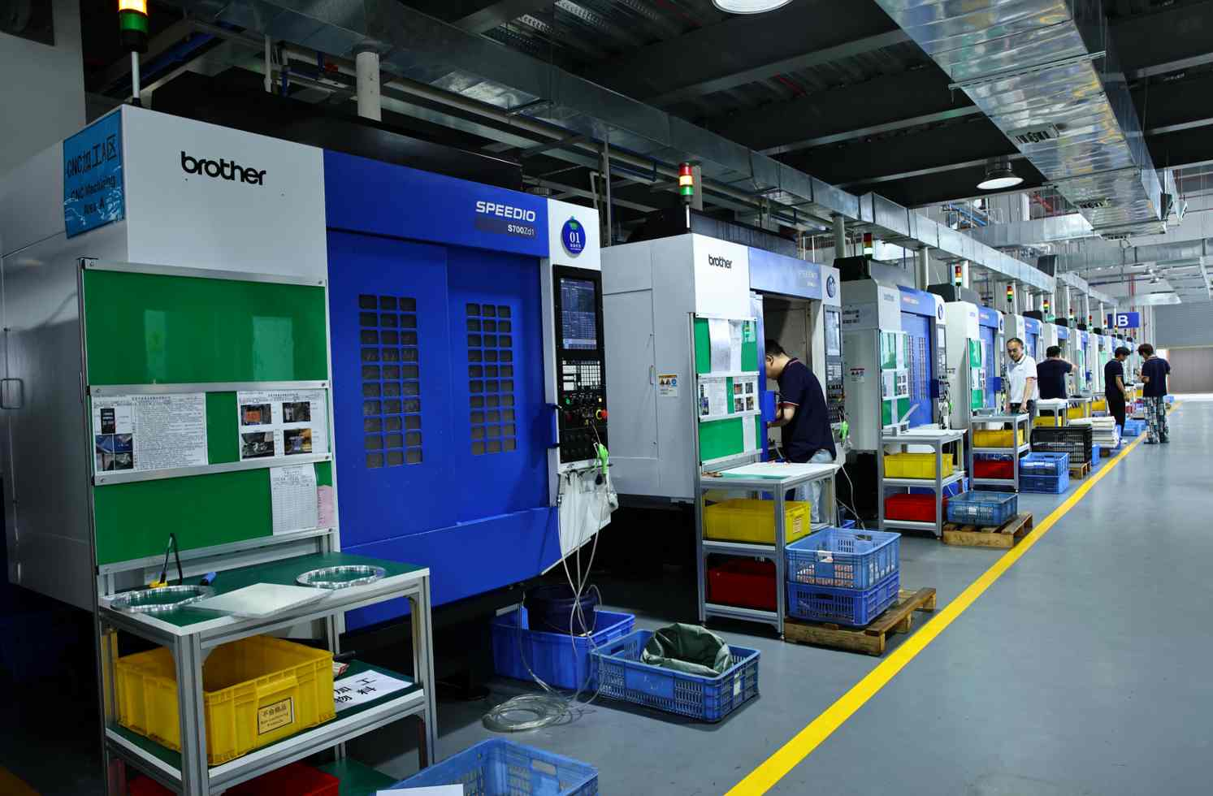
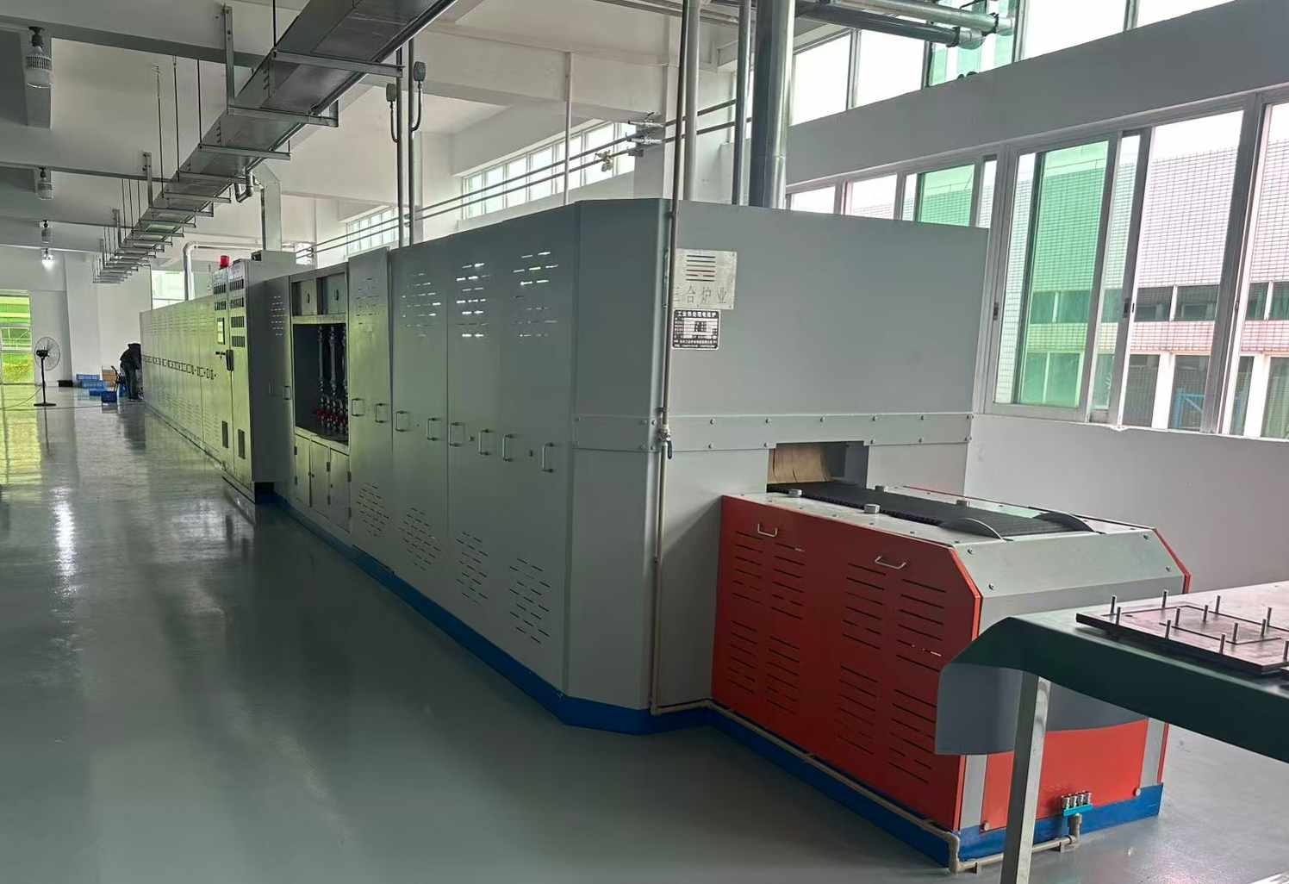
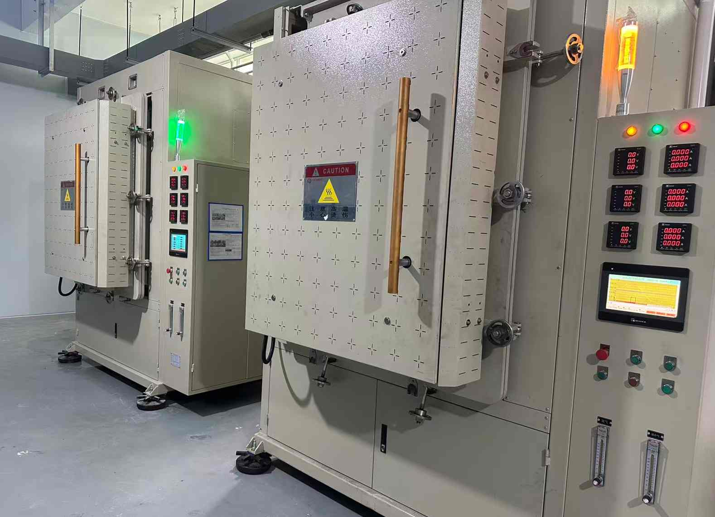
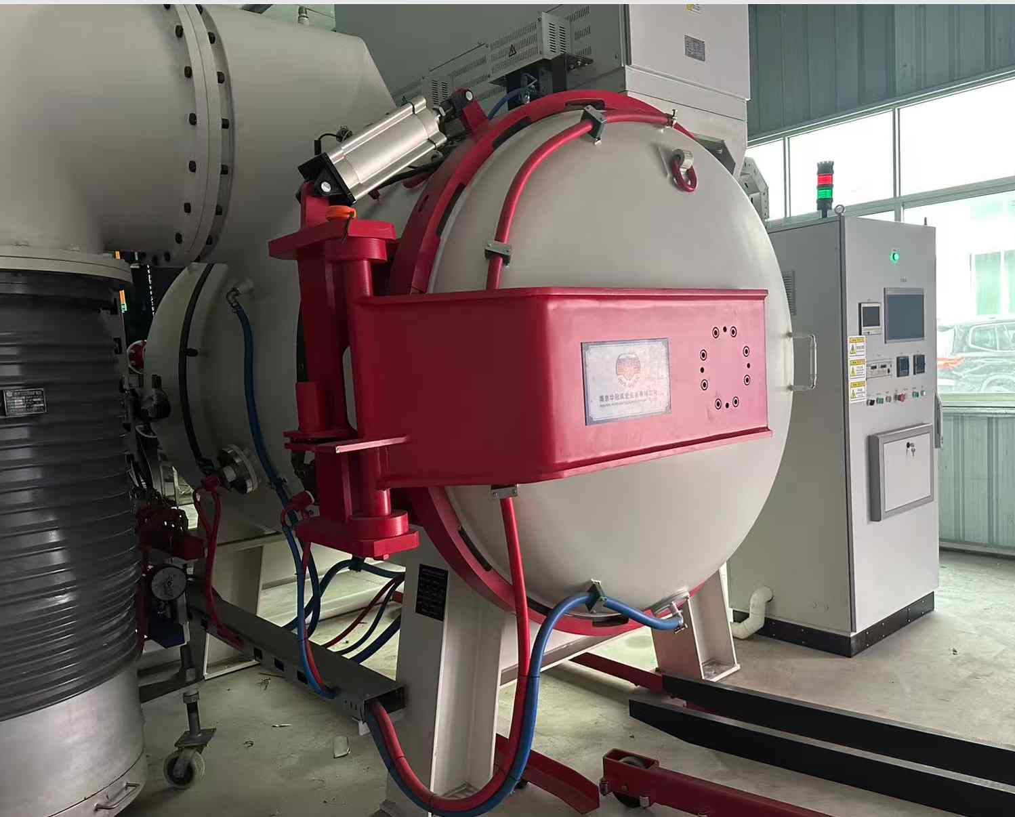
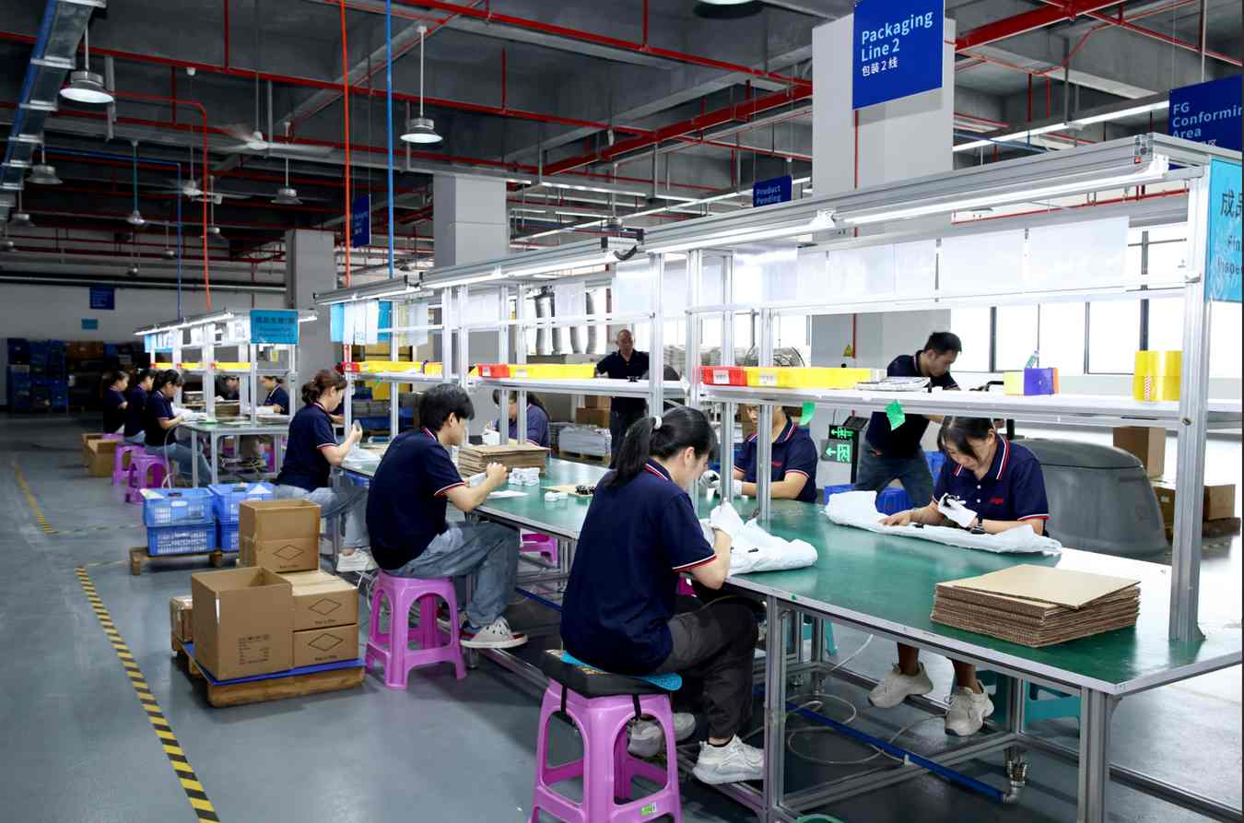
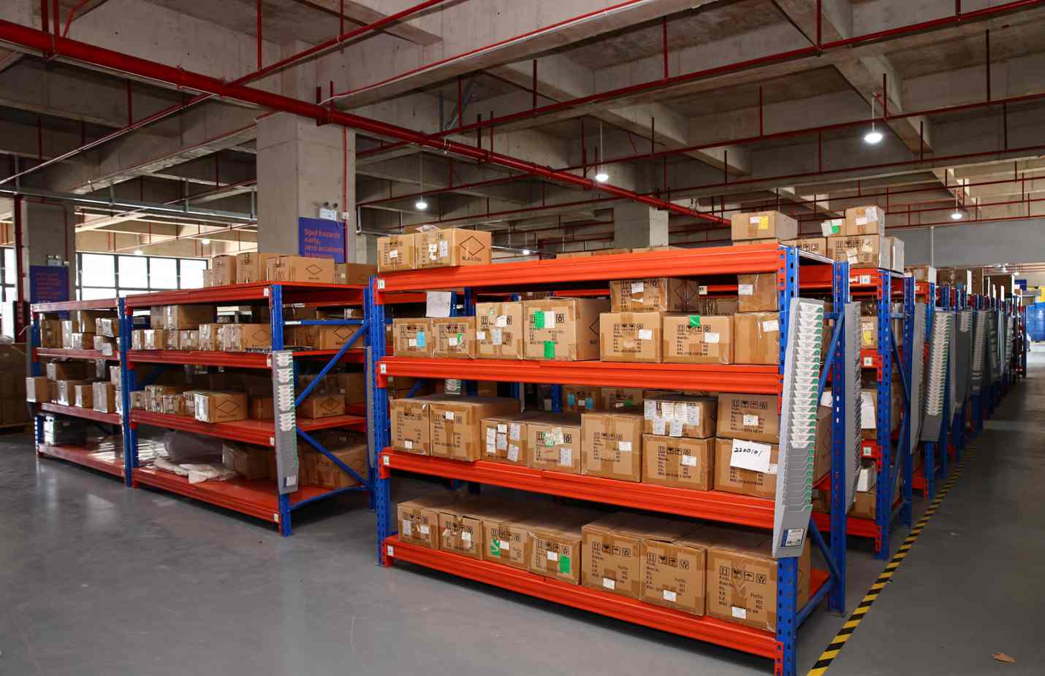
Kenfa factory
Workshop

Slide 22
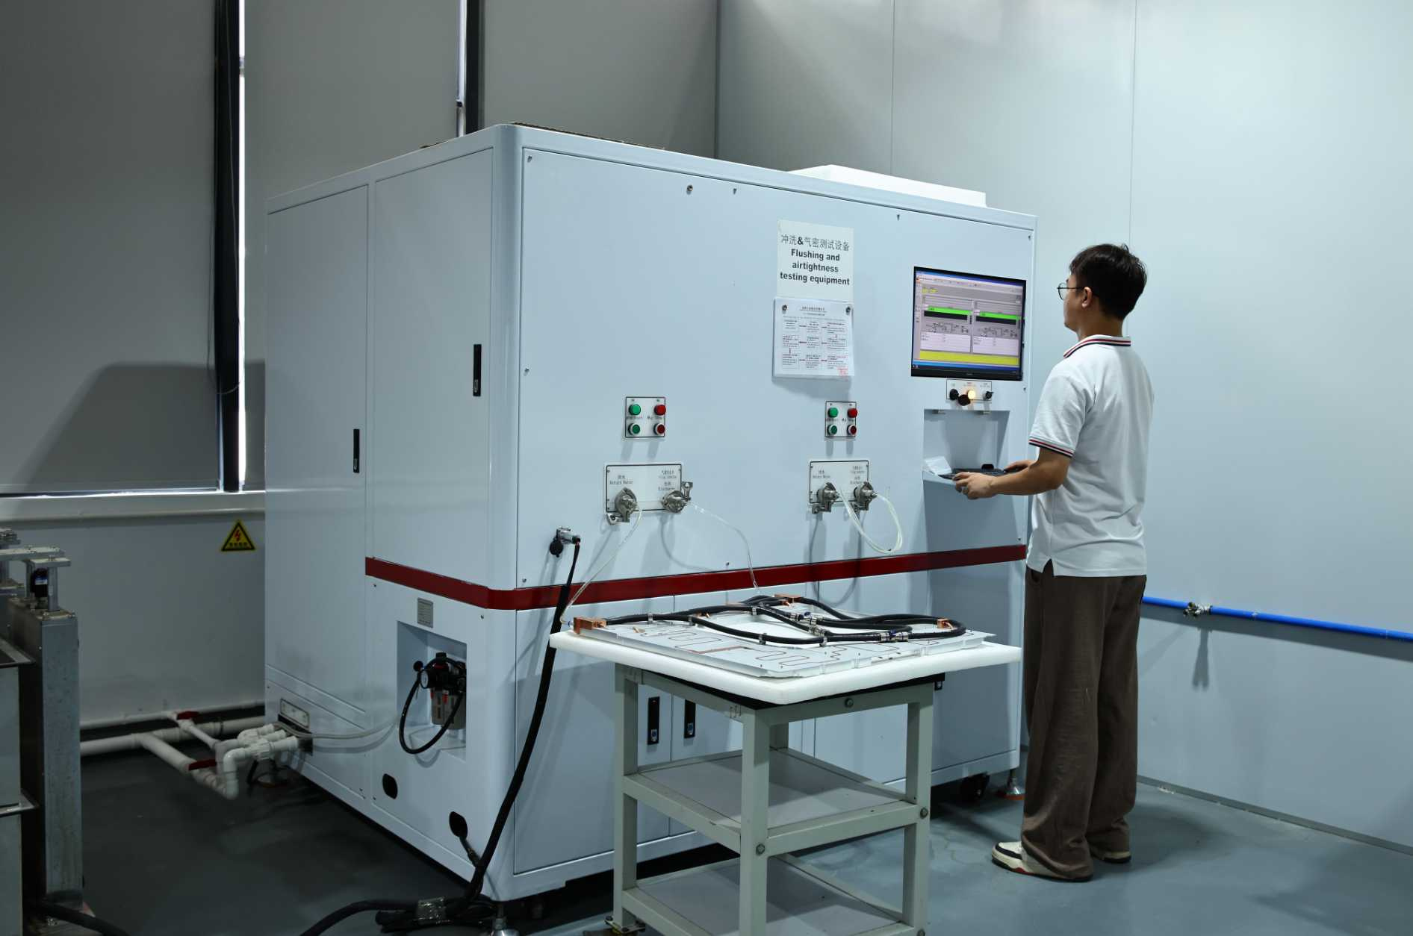
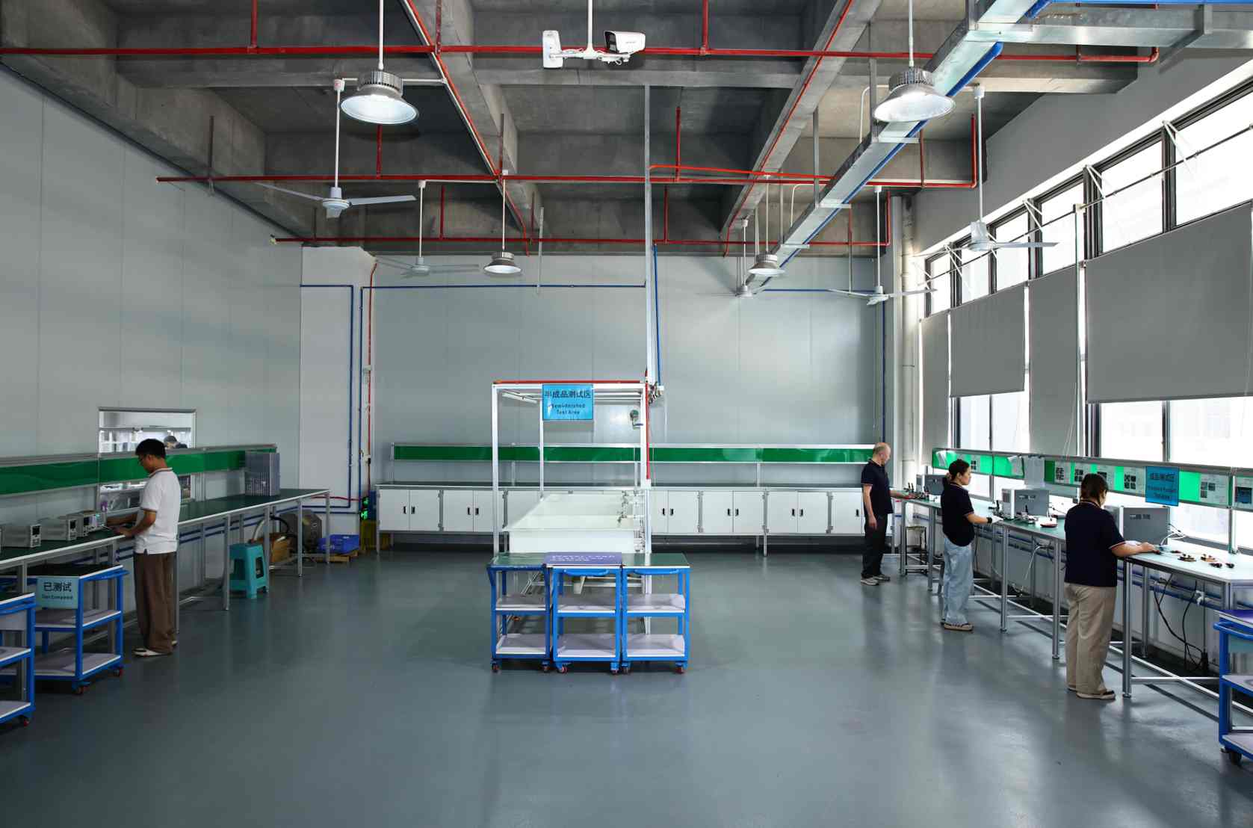
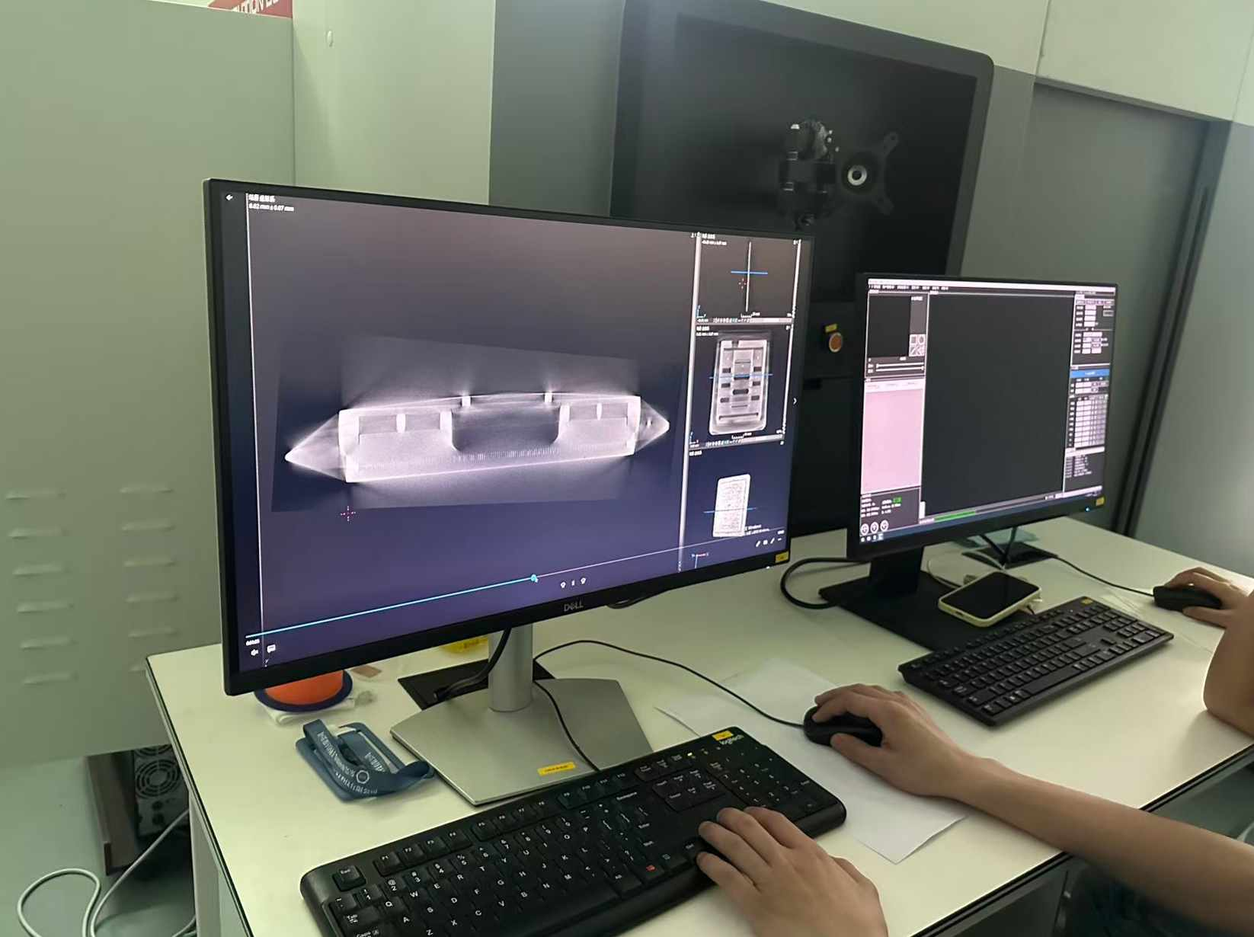
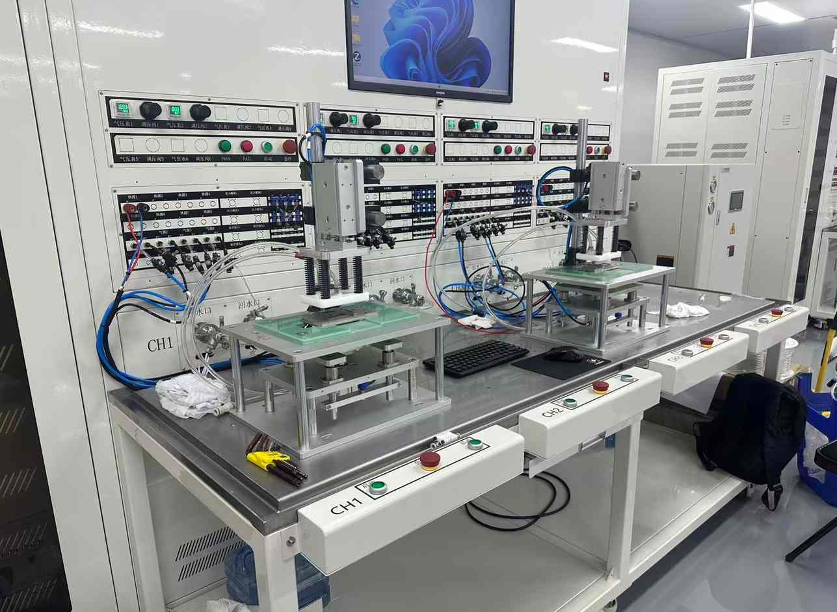


Kenfa factory
Test equipment

Slide 23
Kenfa factory
Thanks!

